Slide 1
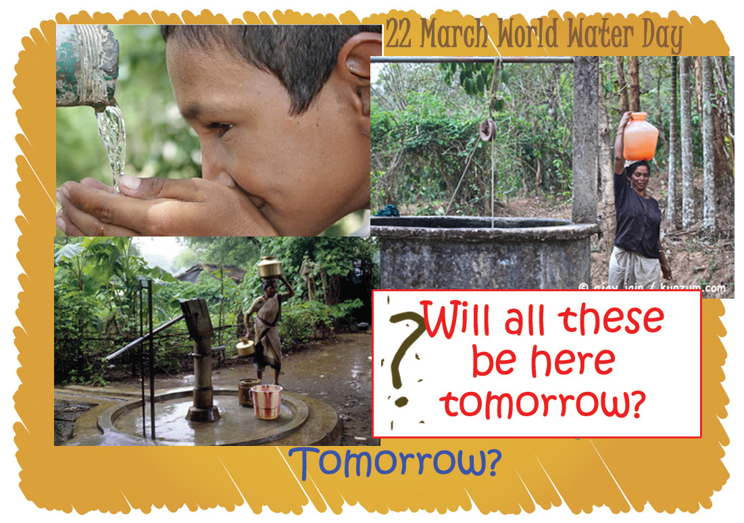
chapter – 12 WATER ON EARTH

Slide 2
Earth is the only living planet in the solar system. The life is originated in water.
As 71 percent of the earth's surface is covered with water, it appears to be blue

Slide 4
Water cycle

Slide 5
Oceans, rivers, lakes and backwaters are the sources of fresh water. The water level in these are very shallow. Wells, ponds, tube wells etc. are the sources of ground water.

Slide 6
Water below the ground
Porosity:
Rain drops percolate into the tiny pore spaces of the soil and get collected there. There are numerous pore spaces in the soil.
Porosity is the term for the porous state. Clay is an example for porous material.
Some rocks are also porous. Such rocks can absorb more water.

Slide 7
Permeability :
But water will be available only at places where the pores in the rocks are inter-connected. This is due to the fact that water can move through these pores. This quality of rocks is known as permeability.

Slide 8
All porous materials need not have permeability. For example, clay has high porosity but low permeability.

Slide 9
Nature has arrangements to store rain water for rainless periods.
Water scarcity will be the result if we disrupt the chances of water to percolate into the ground.

Slide 10
' water table'. &'underground water'.
The surface of the water-rich part beneath the ground is known as' water table'.
The water stored beneath the ground is the 'underground water'.

Slide 12
Multitude of wells
Tube well :
It is difficult to dig wells where the water table is deep. Tube wells are ideal in such situations. Tube wells are dug on rocks with the help of machines

Slide 13
Filter point wells
The term filter point wells are used for the shallow tube wells dug in sandy regions.

Slide 14
Artesian wells
Let there be a permeable rock layer in between two impermeable rock layers. Water will rise to the surface automatically due to pressure if we dig to this permeable rock layer. Such wells are known as artesian wells.

Slide 16
Spring:
Water will be flowing out along the surface wherever water table touches the ground. This is known as "spring".
At some places such water flows are characterised with hot water. These ar known as hot springs.

Slide 17
Geysers:
The phenomenon of severe ejection of water from within the earth at regular intervals is known as "geysers".
Example - The Old Faithful geyser of the Yellow Stone National Park in U.S.A.

Slide 18
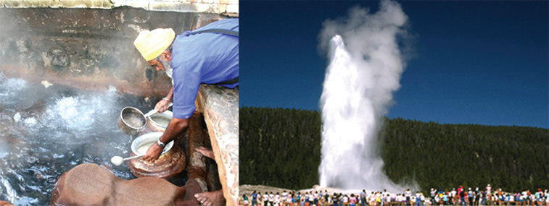

Slide 19
The water that seeps through the fissures on the earth comes in contact with the magma and leads to the formation of hot springs and geysers.

Slide 20
Wetlands
Wetlands are natural sinks of surface water.
Paddy fields, ponds , swampy region and all low lying regions come under the category of low lands.
The water stored here form part of the ground water.
Reclamation of the wet lands led to
Lowering of water level in wells.
Floods become common in rivers even in slight rains.

Slide 21
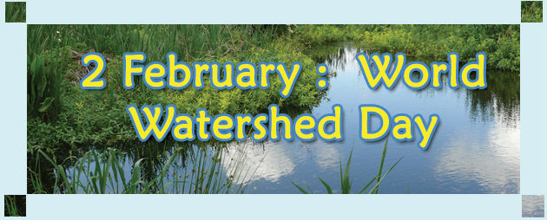

Slide 22
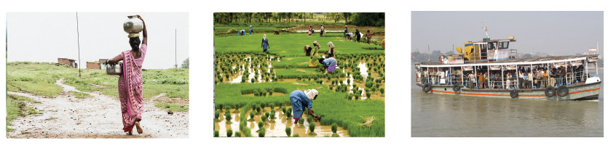
Uses of water
List out the uses of water….

Slide 23
Threats to water resource

Slide 24
Not a drop to drink
The total quantity of water on earth is constant. Hence the percapita availability of water decreases with increase in population. Increase in the consumption of water has also influenced the availability of water.

Slide 25
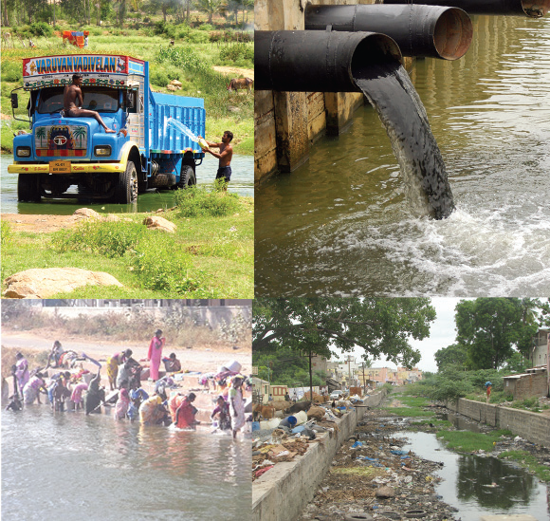
Water pollution

Slide 26
The undesirable change in the physical, chemical and biological properties of water is termed as water pollution.
We have a law enforcing the control of water pollution in our country. It is known as the law on prevention and control of water pollution

Slide 27
Ill effects of water pollution
Water pollution not only affects the availability of fresh water, but leads to the pollution of land and air as well.
The survival of plants and animals are put to danger.

Slide 28
Water Conservation
Nature provides enough water for us.
We can solve the issues of water scarcity and drought if we make use of the rain water effectively.
Flood can also be controlled to some extend through this.
Soil is the largest store house of water.
Allowing each drop of rain water to percolate at the place where it falls is the basic principle in water conservation.

Slide 29
Rain water Harvesting
Harvesting rain water is the best way to solve the problem of water scarcity. It can be done by different ways.
Roof top rainwater harvesting.
Surface runoff harvesting.

Slide 30
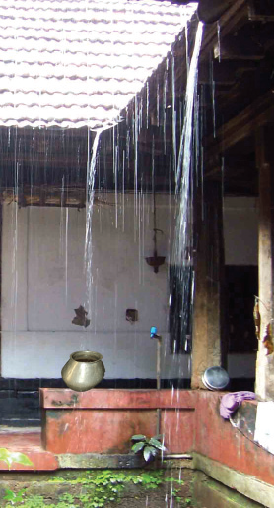
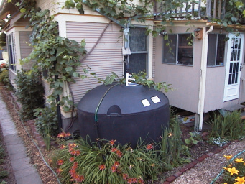

Slide 31
Roof top rainwater harvesting
The level of the underground water can be raised either by draining the rain water to the ground or by collecting it in storage tanks.

Slide 32
Storage of surface runoff
The following activities would be helpful in collecting and storing the rainwater in the soil.
Conservation of wet lands
Protection of forests
Terrace farming
Mulching
Construction of check dams
Construction of mud walls
Digging rainwater percolation pits

Slide 33
Recycling of water
Water drained from kitchen can be used for watering vegetables raised in the courtyard.
Through this method we Can avoid using drinking water for other purposes

